Slide 1
DBIDS Virtual Enrollment System (DVES)
Virtual Visitor Pass Request
Homestead ARB
482 SFS/S5V

Slide 2
Virtual Pass
WHAT IS NEEDED TO CONDUCT A VIRTUAL PASS
Visitor Creates a DBIDS Profile on https://dbids-global-enroll.dmdc.mil
Provide QR code to Sponsor
Visitor provides a scanned front & back photocopy of a Real ID compliant State or Federal issued identification to the Sponsor
Sponsor provides above QR code, Real ID photocopy, and completed FEW Visitor Request form to 482SFS.VCC.HomesteadARBVCC@us.af.mil

Slide 3
Step 1
Visitor visits the following website and fills out a Pre- Enrollment Request located at:
“https://dbids-global-enroll.dmdc.mil”

Slide 4
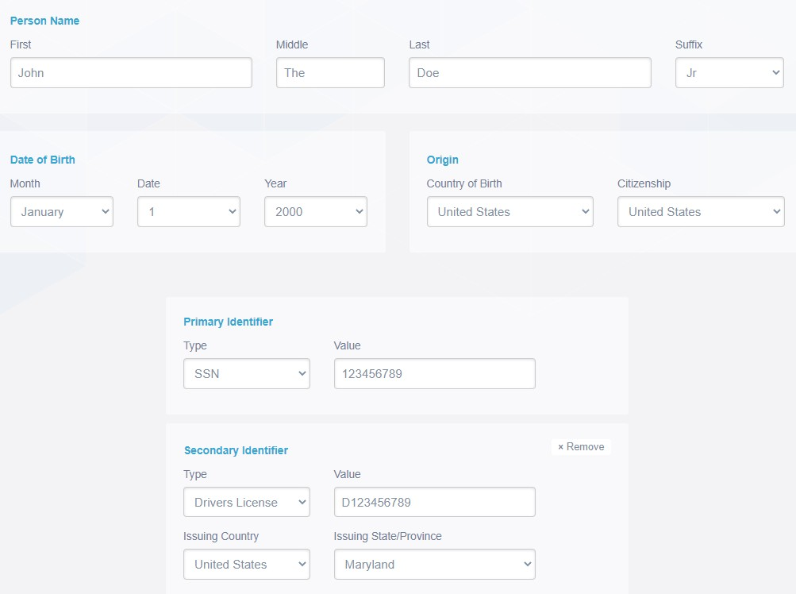
Step 1 Cont.
Visitors legal first, middle, and last names (suffix if applicable)
Visitor’s date of birth and citizenship
Visitor’s Social Security
number
Visitor’s valid credential information

Slide 5
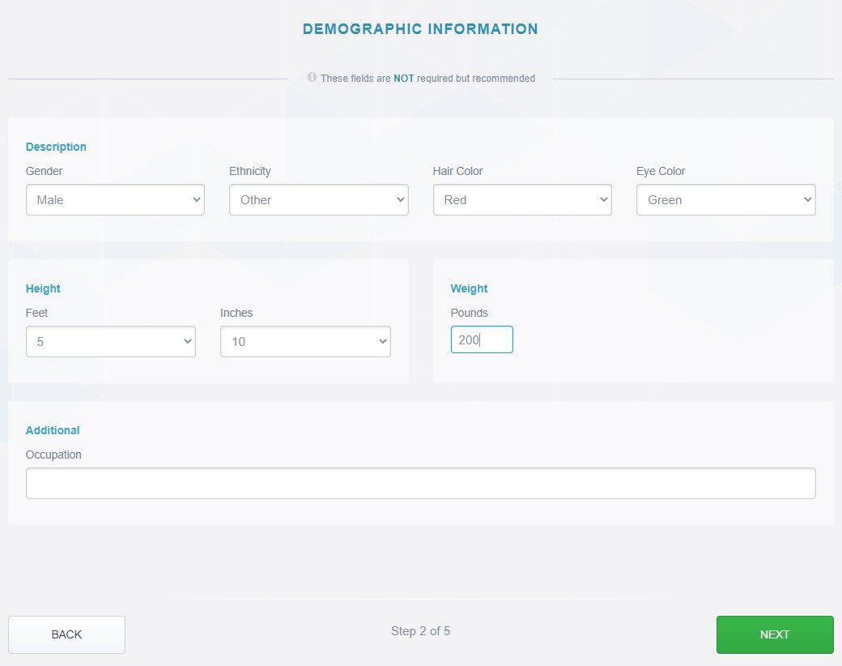
Step 1 Cont.
Visitor’s description matching valid credentials
Visitor’s height and weight

Slide 6
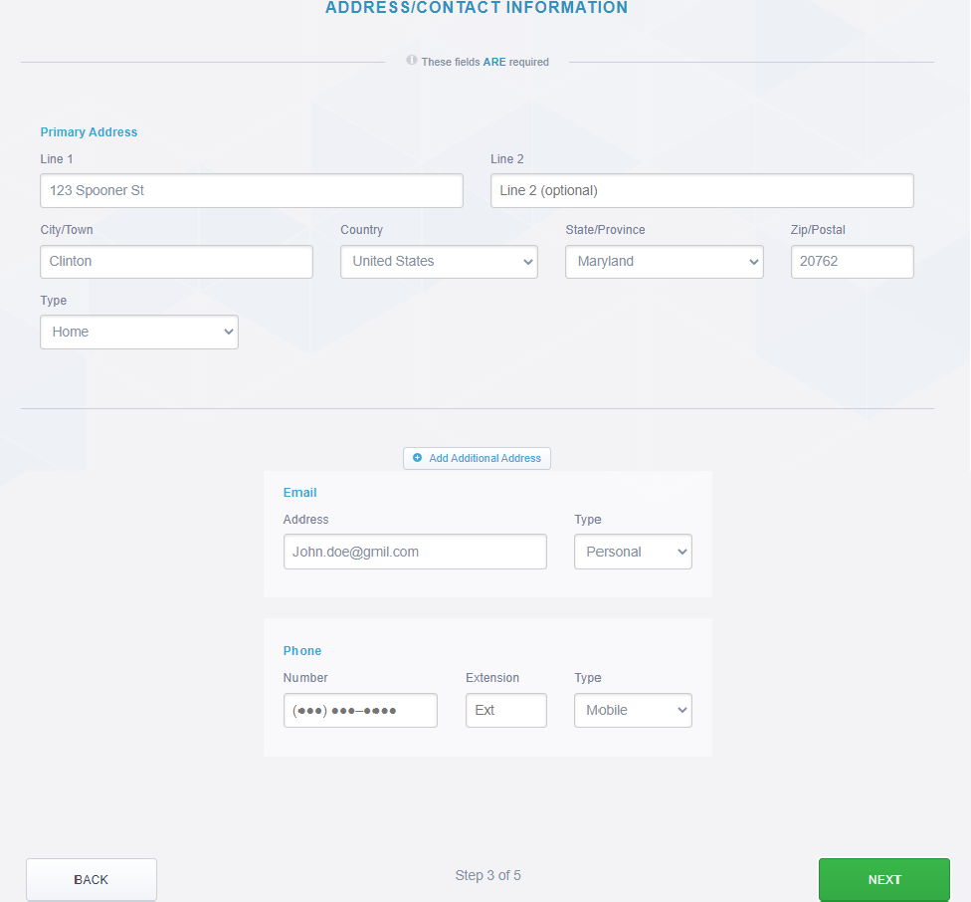
Step 1 Cont.
Visitor’s physical address
Visitor’s Email
Visitor’s phone number

Slide 7
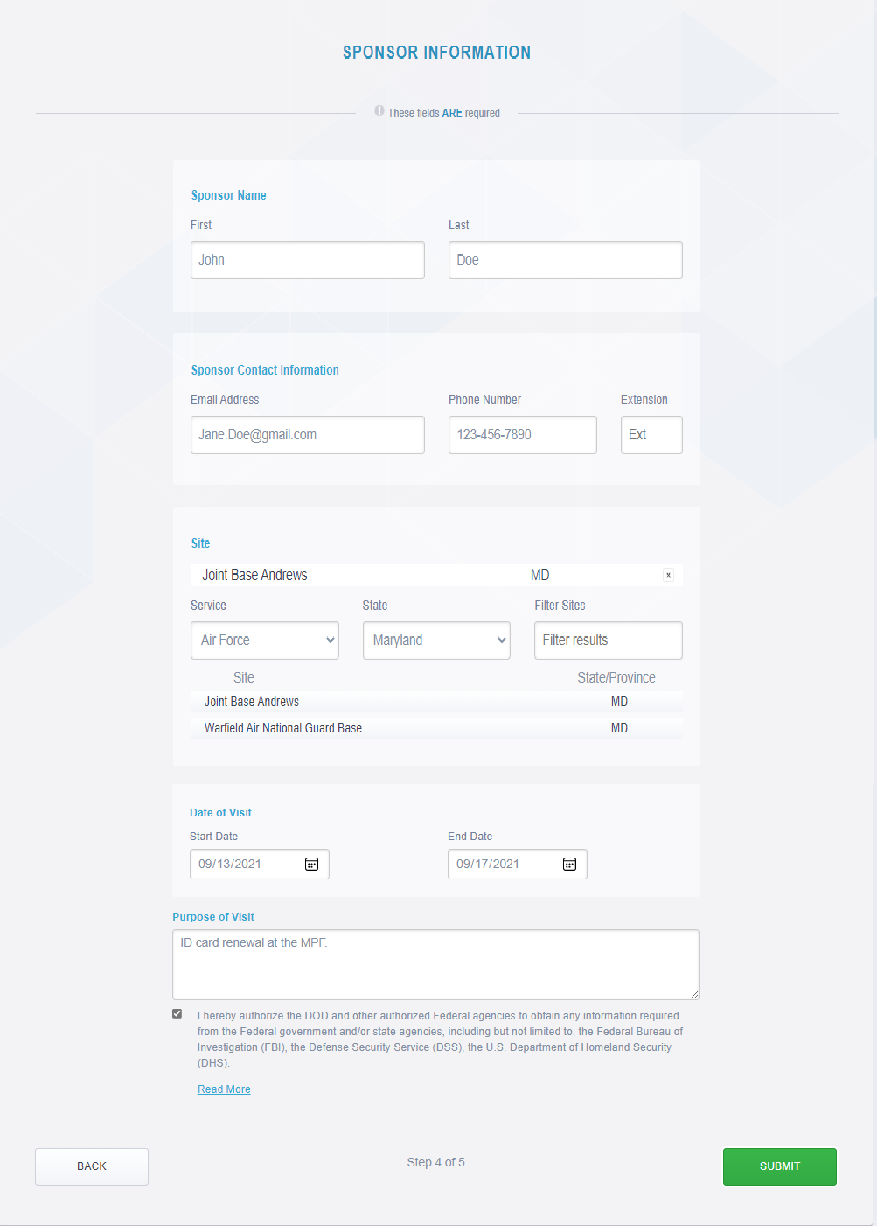
Step 1 Cont.
Sponsor’s first and Last Name
Sponsor’s contact information
Installation visitor is requesting access to
Duration of Visit (Cannot exceed 30 calendar days)
Purpose of Visit

Slide 8
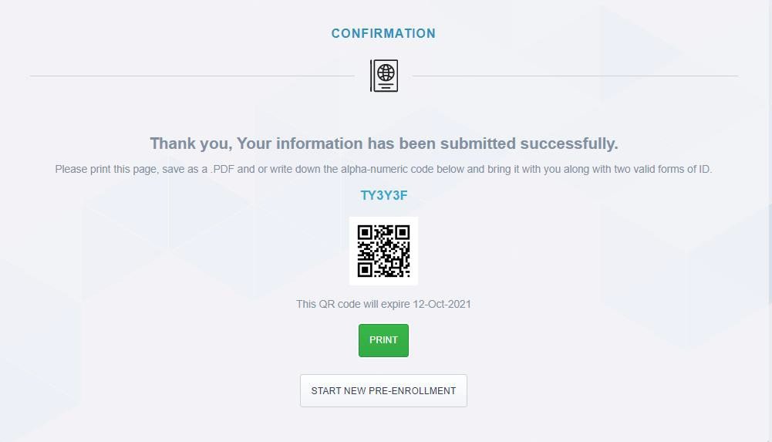
Step 1 Cont.
The Visitor will save (Print as PDF) this confirmation page to send to the Sponsor.

Slide 9
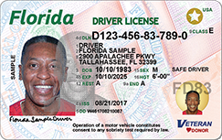
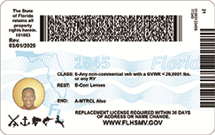
Step 2
Visitor scans both the front and back of their Real ID compliant photo identification and provide to Sponsor

Slide 10
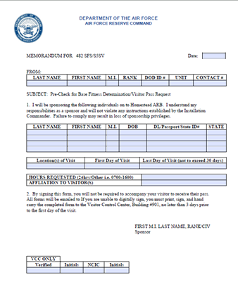
Step 3
Sponsor will complete Homestead ARB Visitor Pass Request Form
Sponsor can find the Visitor Request form on Homestead Air Reserve Base (af.mil)
Sponsor can request this form via email @ 482SFS.VCC.HomesteadARBVCC@us.af.mil

Slide 11
Sponsor to Finalize
Sponsor will gather the below items from each visitor:
Pre-Enrollment Request Confirmation (QR code) – Step 1
Copy of Visitor’s Real ID compliant ID (front & back) – Step 2
Complete Homestead Visitor Request Form – Step 3
Sponsor will provide to 482 SFS/S5, VCC Section via
Email: 482SFS.VCC.HomesteadARBVCC@us.af.mil
Hand-carried: Building 901, Mon – Fri and Sat(UTA), 8:00 am – 4:00 pm
*NOTES:
After VCC processes the visit request, an email will be sent to the Sponsor with the finalized “Visitor Pass”
“Visitor Pass” and Real ID Compliant ID will be scanned at the base gate for base access

Slide 12
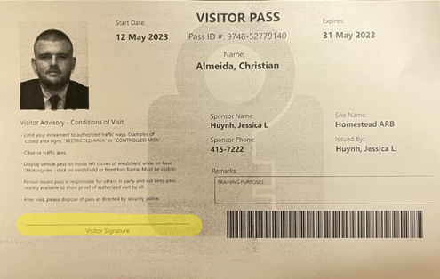
Visitor Pass Example
After VCC processes the visit request, an email will be sent to the Sponsor with the finalized “Visitor Pass”
“Visitor Pass” will be scanned at the base gate for base access
Visitor signs pass and proceeds to base gate

Slide 13
Virtual Passes
CONTACT INFORMATION:
For any questions or concerns please contact the Visitor Control Center
Phone: (786) 415-7222
Email: 482SFS.VCC.HomesteadARBVCC@us.af.mil
Hours: Monday – Friday, Saturday (UTA), 8:00 am- 4:00 pm

